Slide 1
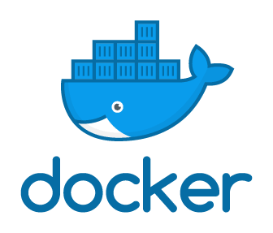
Sokwhan Huh
May 2nd, 2019
Kunz, Leigh and Associates

Slide 2
Take a picture!
https://github.com/shuhkla/docker-demo

Slide 3

Distributed Cloud Operating System
KUBERNETES
AUFS
DEV = PROD
Orchestrators
Swarm
Multi-stage deployment
Saving $$$
Microservices

Slide 4
Let’s start small
What is it?
Why use it?
How to use it?

Slide 5
What is Docker?

Slide 6
What is Docker?
Platform for performing OS level virtualization
“containerization”
Docker is NOT a VM
chroot / cgroups / kernel namespaces
“Process Isolation”

Slide 7
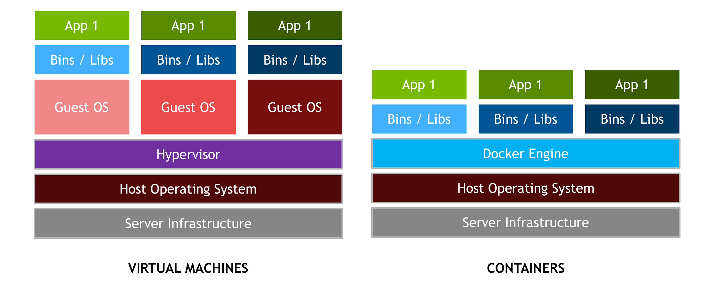
Docker Engine vs. Traditional VM
Source: https://devblogs.nvidia.com/nvidia-docker-gpu-server-application-deployment-made-easy/vm_vs_docker/

Slide 8
Why use Docker?

Slide 9
Deployment made easier
New web app with cutting edge technology!
Angular, .NET Core, MongoDB, Redis, etc.
How do you sell this?

Slide 10
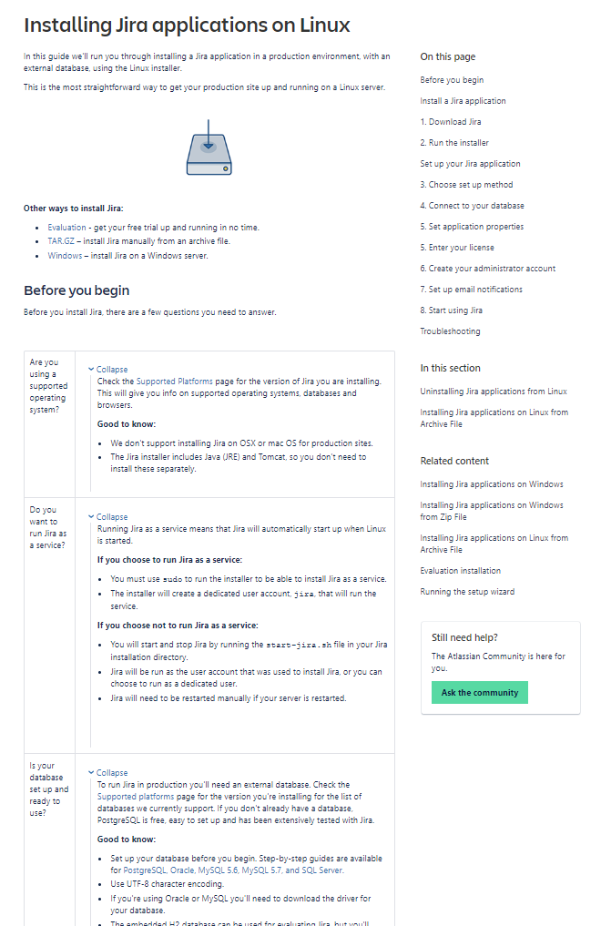
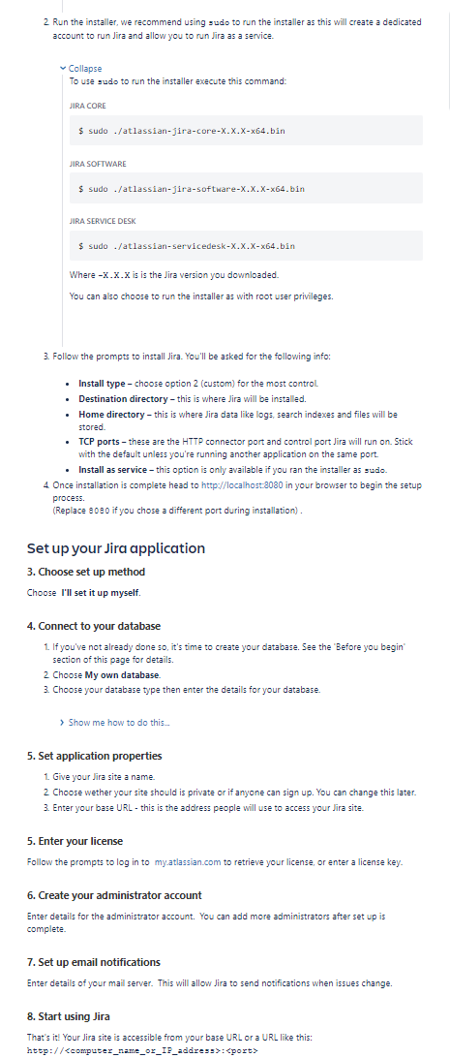
Installing Jira
Source: https://confluence.atlassian.com/adminjiraserver/installing-jira-applications-on-linux-938846841.html

Slide 11
Installing Jira
Or we can just run..
docker run -d -p 8080:8080 cptactionhank/atlassian-jira:latest

Slide 12
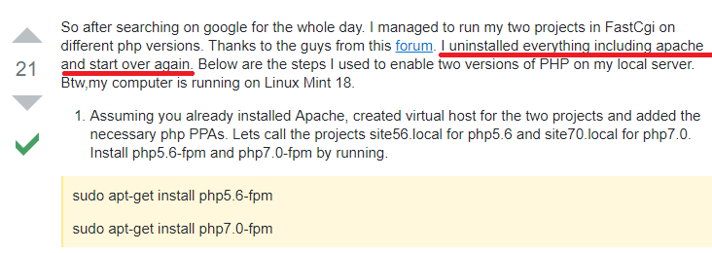
Isolation made easier
Existing PHP 5.1 Application on a server
Need to install PHP 5.4 Application
Source: https://stackoverflow.com/questions/42696856/running-two-php-versions-on-the-same-server

Slide 13
Or you could just spawn two separate containers..
docker run {your first app with 5.1}
docker run {your second app with 5.4}

Slide 14
Development made easier
Quickly get a local database up and running
Messed up your database? Recreate it!
Need to install million dependencies to compile your code
Run it in docker!

Slide 15
How to use Docker?

Slide 16
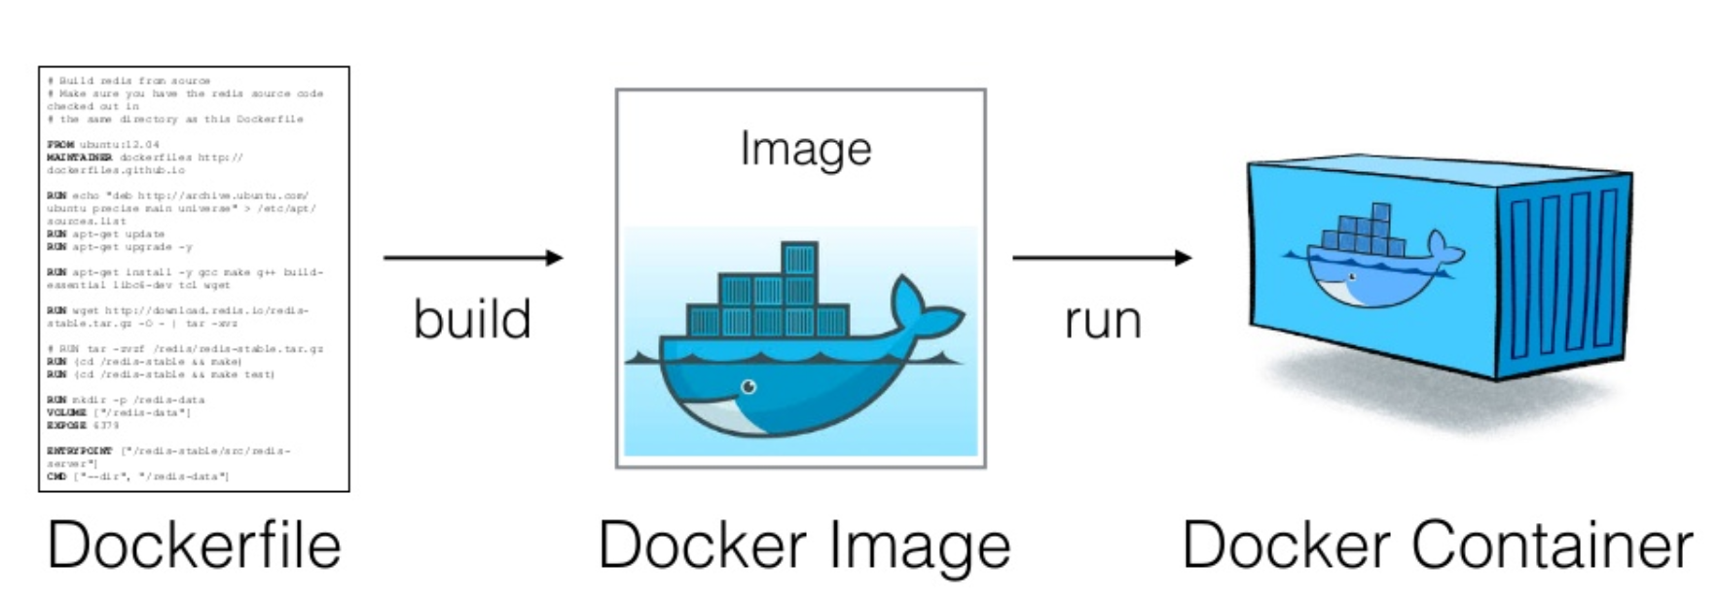
In a nutshell..
Source: https://www.slideshare.net/vincenzoferme/using-docker-containers-to-improve-reproducibility-in-software-and-web-engineering

Slide 17
Writing a Dockerfile
1. Start from a base image
2. Execute commands with RUN
3. Copy any local files into the image
4. Specify default application to run
FROM ubuntu
RUN apt-get update
RUN apt-get install -y nginx
COPY index.html /var/www/html/
ENTRYPOINT ["/usr/sbin/nginx","-g","daemon off;"]

Slide 18
Image/Container
Build the image
docker build -t myimage:latest .
Images can be versioned (latest vs v1)
Run the container
docker run -d -p 1500:80 --name webserver myimage
Docker commands in general have a lot of optional arguments. Be sure to refer to the documentation often https://docs.docker.com/v17.09/engine/reference/commandline/run/

Slide 19
More useful commands
View containers
docker container ls (Running containers)
docker container ls -a (All existing containers)
View all images
docker image ls
Run bash in a running container
docker exec -t -i your_container_name /bin/bash

Slide 20

Docker networking
1500
Port 80 | Container 1
8080
Port 80 | Container 2
DockerHost
Default Bridge Networking

Slide 21
Further Things to look into
docker-compose
Storage Driver
Don’t use AUFS (default)
Use something more modern like overlay2
Automatic Deployment / Orchestration
Kubernetes
v2tec/watchtower, ouroboros

Slide 22
Q & A

